Slide 1
The Method to Methods

Slide 2
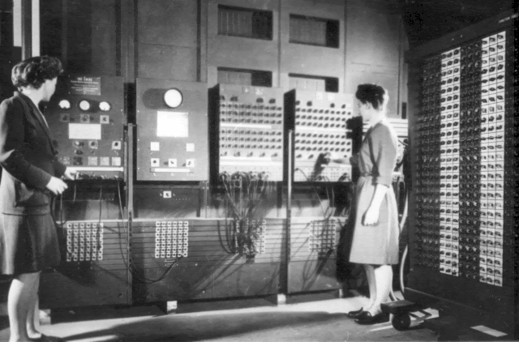
Reusable Code
Programming == Problem Solving
You look at the problem to solve
Clarify the problem and constraints
Break it up into *smaller* parts (Divide)
Outline the steps needed
Solve each step (Conquer)
Reassemble the pieces (Glue)
Completed program
The ENIAC women pioneered reusable code
But they also needed ways to modularize code
Over the years - Object Oriented Designed
Programmers Betty Jean Jennings (left) and Fran Bilas (right) operate ENIAC's main control panel By United States Army (Image from http://ftp.arl.army.mil/~mike/comphist/) [Public domain], via Wikimedia Commons
Divide
Conquer
Conquer
Conquer
Glue

Slide 3
Method Syntax Basics
[scope] [static] TYPE name(parameters) {}
public static void main(String[] args) {...}
public - is the scope of the method (optional)
static - access type (option)
void - return type (required)
main - method name (required)
String[] args - are parameters for the method
Having parentheses is required
something inside, optional
public double getPercentGrowth(double startingSalary, double midCareerSalary) { …}
public - is the scope of the method
access is not there - that means “instance”
double - return type
getPercentGrowth - method Name
double startingSalary, double midCareerSalary - are parameters for the method

Slide 4
Static vs. Instance Methods
Harder concept (we will come back to it later)
Think of static as shared memory
Variables in it are easily overwritten
Static methods need to be self contained, and only access shared information
Instance methods belong to the object
They need information from the object
They provide the main functionality to the object
Most common

Slide 5

Method Name & Parameters
They should have meaning!
They follow the same rules as variable names
No specials, start with letter, etc
Parameters are part of the name
getArea()
getArea(int x)
getArea(int x, int y)
Are three different methods! (Be careful)
The secret ninja trick for methods
Pass in the variables
Try to keep everything as contained as possible
What is your quest?
What is it you return
What do you know
What do you need (parameters)

Slide 6
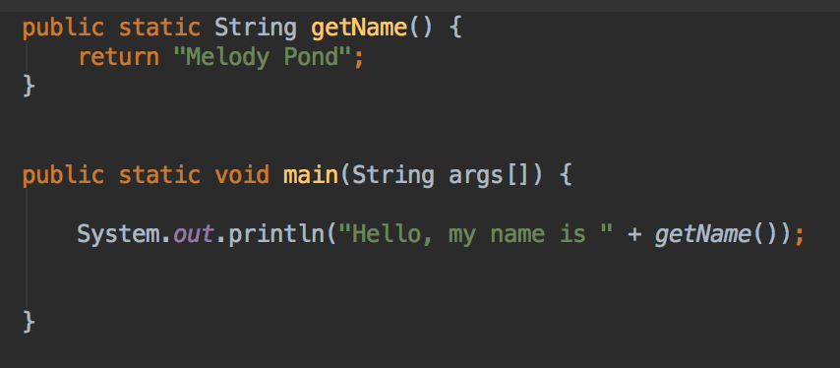
Return Types
Return Types
Critically important
Can return a primitive, array or an object
void is how you say the method returns nothing
Whenever you call a method
Assume the return type is what is returned
Think of replacing the method name with the answer
The program output is
Hello, my name is Melody Pond
Notice: Melody Pond simply replaces ‘getName()’

Slide 7
Why Methods and Objects?

Slide 8
DRY Code
Fun Fact:
Software Engineers, Andy Hunt and Dave Thomas, are credited with first using the the term for coding in the The Pragmatic Programmer
Code should be DRY
Don’t Repeat Yourself
Code should be
Reusable
Small Snippets
Reusable code
Only write once
Use in multiple applications
Java
Methods are blocks of reusable code
Ideally, no more than 20 instructions
Objects are blocks of information, with reusable code / methods
CLUE: If you are cutting and pasting code - it should be a method
Really, that happens
Divide
Conquer
Conquer
Conquer
Glue

